Slide 1
LIVER TRASPLANT IN A PATIENT WITH SYNDROMATIC BYLE ATRESIA
WTHOUT POLYSPLENIA CASE REPORT
Dr. Ishtar Cabrera Lozano//Dr. Nidia De Monserrat Arreola Gutiérrez// Dr. Antonio Murillo//Dr. José Manuel Zertuche//Dr. Verónica Paredes Escalera
September 2024

Slide 2
Introduction
Biliary atresia (BA) is obliterative cholangiopathy
Syndromic BA is associated with other congenital anomalies.
This occurs in 10% of patients
it´s believed that there is a relationship between BA and maternal diabetes.
Interruption of the inferior cava vein
Preduodenal portal vein
Abnormal intestinal rotation
Complete visceral transposition
Cardiac anomalies
Polysplenia
Ruíz N, Patricia, Aguirre R, Karen, Mesa M, Catalina, & Lara L, Lilian. Atresia biliar sindrómica en un paciente pediátrico: Reporte de caso. Revista colombiana de Gastroenterología, 2015; 30 (4), 447-455.
Schwarz KB, Haber BH, Rosenthal P, et al. Extrahepatic anomalies in infants with biliary atresia: results of a large prospective North American multicenter study. Hepatology 2013; 58:1724

Slide 3
Objetive
Experience of a patient with syndromatic bile duct atresia and a related living donor liver transplant (LDLT).

Slide 4
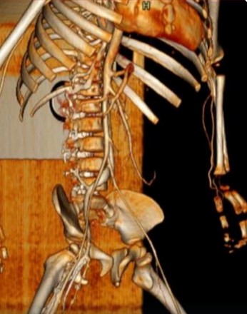
Clinical report
Female 1 year 6 months old
Maternal history of type II diabetes
Started suffering from Cholestatic jaudince at 15 days of life
Diagnosis of type III BA
Plus another clinical features:
Malrotation
Pre-duodenal portal vein
Cardiac anomalie Intraventricular septal defect
shunt from left to right with a gradient of 60 mm without hemodynamic repercussion
Foramen ovale of 2 mm
Dyslipidemia

Slide 5
Evolution
She did not have bile clearance
With little growth with a weight of 7.5 kg
Liver failure with a CHILD – PUGH B with 7 pounts and PELD 24 pounts
It was decided to perform an LDLT.
Appendectomy and placement of a biodegradable biliary stent in the roux.
Presented partial thrombosis of the portal vein in hepatic segment II.

Slide 6
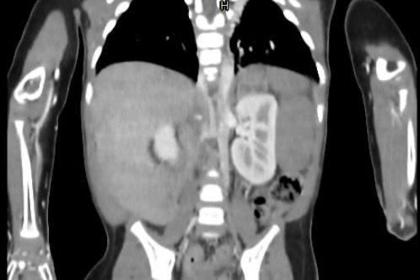
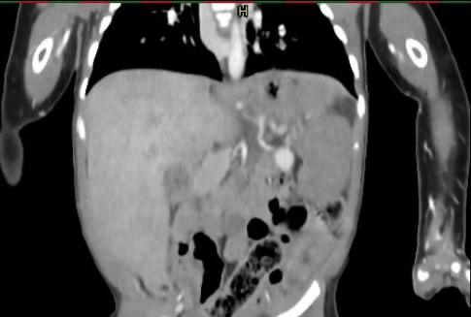
Angiotomography

Slide 7
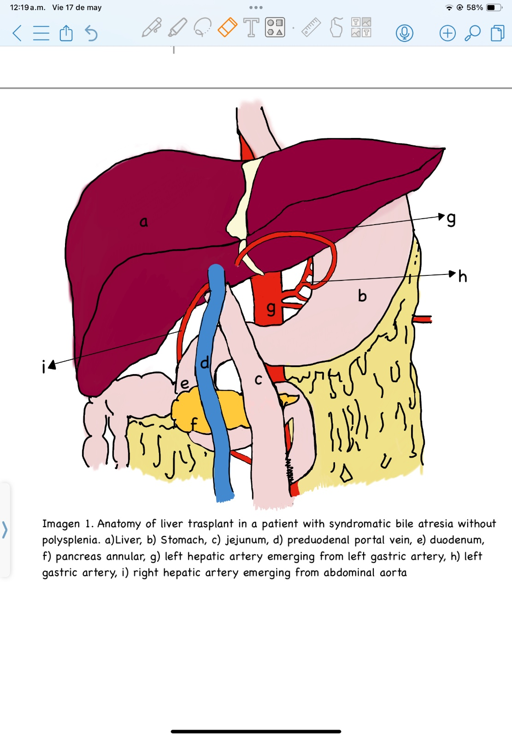
Trasplant surgical findings
Liver anatomy of syndromatic biliary atresia without polysplenia.
Liver
stomach
jejunum
preduodenal portal vein
Duodenum
annular pancreas
left hepatic artery emerging from left gastric artery
left gastric artery
i) right hepatic artery emerging abdominal aorta.

Slide 8
Conclusion
The anatomical variants of a syndromatic atresia require great knowledge and vascular control so as not to lose the only possibility of arterial and portal anastomosis that the patient has, in this case the total release of the portal vein without injuring the pancreas or the duodenum represented a challenge.

