Slide 1
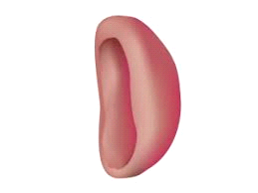
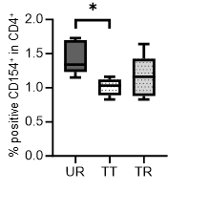
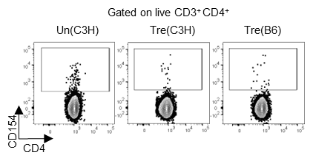
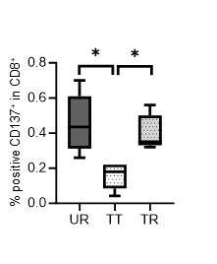
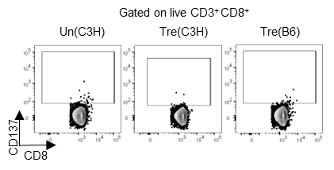
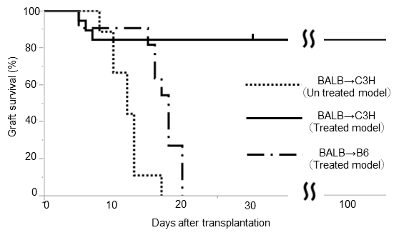
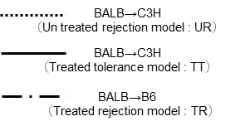
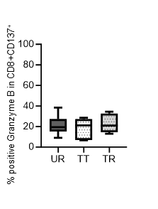
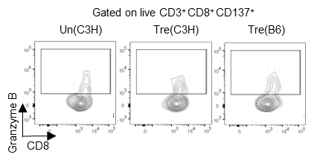
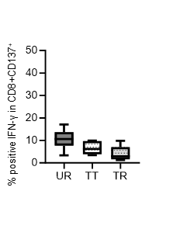
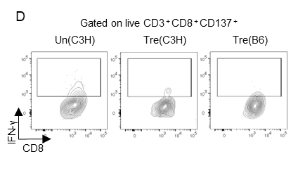
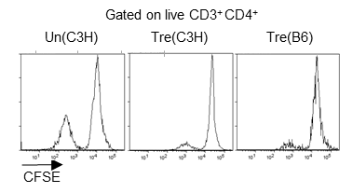
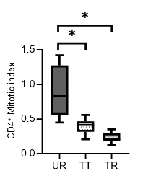
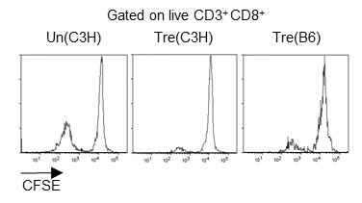
Novel method of immune monitoring based
on alloreactive T cells
Department of Gastroenterological and Transplant Surgery, Graduate School of Biomedical and Health Sciences, Hiroshima University
Ryosuke Arata, Naoki Tanimine, Ryosuke Nakano, Hiroshi Sakai, Masahiro Ohira, Hiroyuki Tahara, Kentaro Ide, Yuka Tanaka and Hideki Ohdan
Introduction
Allo-reactive assay
The detailed analysis of alloreactive T cells provides critical insights into transplant immunology. Our study confirmed that the analysis method focusing on alloreactive T cells accurately reflects the rejection response following mouse skin transplantation. In this research, we further evaluated the utility of this method using a peripheral immune tolerance model.
CFSE Labeld
BALB
40G
Stimulated B cell
Un treated model
spleen
B cell
isolation
CD40L+IL-4
(24hr)
radiation
stimulator
14hr
Method
D7
T cell
Monensin
BALB
C3H
spleen
T cell isolation
responder
18hr
Peripheral immune tolerance was induced using CTLA-4-IgG and anti-CD40L antibodies in a skin transplantation model (BALB/c→C3H or B6). Seven days after transplantation, B cells derived from BALB/c mice were activated with CD40L and IL-4 for 24 hours, cultured as stimulators, and then co-cultured with recipient spleen T cells for 18 hours in a one-way MLR. Alloreactive T cells (CD154+CD137+) were identified and functionally evaluated within CD4+CD8+ T cells using flow cytometry.
Treated model
D7
CD154,CD137
BALB
C3H
spleen
Tcell isolation
T cell
D7
responder
BALB
B6
spleen
Tcell isolation
T cell
Skin Transplantation
responder
Un treated model
Treated model
BALB
C3H
BALB
C3H
B6
Day0,2,4,6 CTLA4-ig
(200µg i.p.)
Day0,2,4 aCD40L (250µg i.p.)
Nature. Vol381. 30. May 1996.
CD4+ and CD8+ cell proliferation was lower in the treated model (TT) compared to the untreated model (UR), with no significant differences observed between the treated models (TT and TR).
In the BALB/c→C3H model, immunosuppression successfully resulted in skin graft survival. However, in the BALB/c→B6 model, despite the extension of the rejection period due to immunosuppression, graft survival was not achieved.
Proliferation assay
B cells derived from BALB/c mouse were activated with CD40L and IL-4 for 24 hours, then co-cultured with splenic lymphocytes from each models for 4 days
to assess cell proliferation capacity.
No significant differences in the expression of Granzyme B and IFN-γ were observed between the treated model (TT) and the untreated model (UR) or among the different treated models (TT and TR).
Differences between treated models that were not observable through cell proliferation evaluation were effectively assessed by focusing on alloreactive T cells.
Result
The analysis of alloreactive T cells provides an effective method for identifying changes in T cell responsiveness during the induction and maintenance phases of immunosuppression in mouse skin transplantation. This approach suggests that quantitative and qualitative analyses of alloreactive T cells are useful for monitoring immune responses post-transplantation.
CD8 mitotic index
CD4+ and CD8+ cell proliferation was lower in the treated model (TT) compared to the untreated model (UR), with no significant differences observed among treated models.
【Conflict of Interest Disclosure】
There are no conflicts of interest to disclose related to this presentation.

