Slide 1
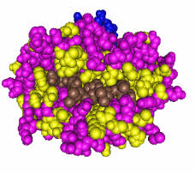


Epitope Matching - The MUST Addition in Donor Selection Algorithm
The 30th International Congress of The Transplantation Society (TTS 2024)
Dhanashree Rahalkar^{1,2}, Karen Dwyer¹, Beata Ujvari¹, Arnab Kapat², Shabari Sarang², Shailaja Gada Saxena²
This research project has been supported by Deakin University, Australia and Reliance Life Sciences, India

Slide 2
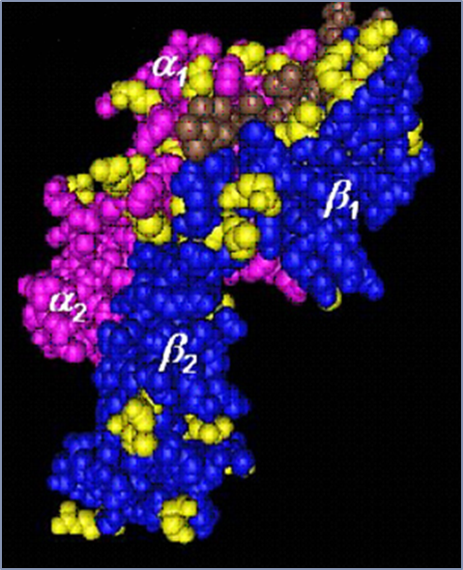
Introduction
Concerns
  Chronic rejection accounts for 63% of graft failure after the first year post-transplant
Limitations with Current donor selection algorithm
  Fails in predicting de novo DSA formation - catalyst for chronic rejection
  Antibodies are not specific for an HLA antigen but for an epitope present on the HLA molecule
  Epitopes - exposed amino acid(s) at the surface of the HLA molecule, accessible for antibody binding
HLA Epitope
HLA Antigen
HLA chain (pink) with β2-microglobulin (blue)showing epitope or eplts in yellow color
Epitopes can be private (present on a single HLA) or public (shared by multiple HLA antigens)

Slide 3


Materials, Methods and Ethics Approval
HLA Typing
  HLA typing using low resolution and high resolution PCR
HLAMatchmaker
  To determine non-self eplet by imputing 04 digit typing to the software
Epitope registry
  Non-self eplets Database of theoretical and confirmed HLA eplets recognizable by B-Cell receptors. Epitopes that are verified experimentally with specific antibodies
  Genepop & Arlequin
  To calculate molecular diversity indices, including allele and haplotype frequencies
Identifying Self
MHC
Identifying Non-Self
MHC
  Ethics Approval
  Approved by Deakin University Human Research Ethics Committee Ref No: 2018-330
Algorithm for assessing donor: recipient HLA compatibility at the level of structurally defined HLA targets called ‘eplets’.
Antibody-verified eplets are eplets that have been verified by human monoclonal HLA antibodies

Slide 4
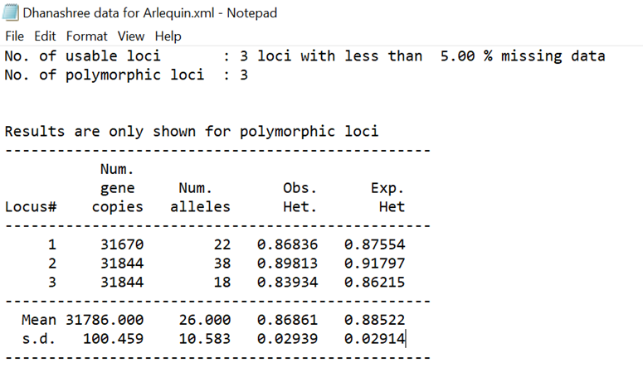
Results
Study Of Eplet Mismatched Loads Against Biopsy Findings
Study Of HLA Haplotype Frequency In Indian Population
Average Antibody Verified Eplets
C4d Negative
C4d Positive
In C4d negative (n=62) patients there were an average 5.58 eplets, while in C4d positive (n=29) patients there is an average of 9.55
eplets. p <0.0001
Molecular diversity for HLA-A,B,DRB1 alleles (n=16900) for 13 states of India using Arlequin shows standard deviation of 0.020 indicating high polymorphism
Number of epiopte mis-matches between donor and recipient ‘the predictor of transplant outcomes’

Slide 5
Practical Application: Case Study
R/D | HLA A | HLA A | HLAB | HLAB | HLA DRB1 | HLA DRB1 | HLA DQB1 | HLA DQB1
Recipient Daughter | 02:01 | 30:01 | 38:01 | 51:01 | 03:01 | 15:01 | 02:01 | 30:01
Donor Mother | 01:01 (MFI 584) | 30:01 | 51:01 | 57:01 (MFI 245) | 03:01 | 10:01 (MFI 764) | 01:01 (MFI 584) | 30:01
SAB profile Class I | MFI
B*15:02 | 19203
B*15:12 | 18978.5
B*50:01 | 18921
B*27:08 | 18647
B*15:01 | 18577
B*07:02 | 18224
SAB profile Class II | MFI
DRB1*16:02 | 6618
DRB1*01:02 | 2330
DRB1*13:01 | 2119
DRB1*01:01 | 1252
DRB1*16:02 | 6618
DRB1*01:02 | 2330
No Donor Specific antibodies
Transplant Done
MFI for Single bead antigen assay is exhibited against corresponding donor antigen in light green color and shows negative expression for donor specific antigens

Slide 6
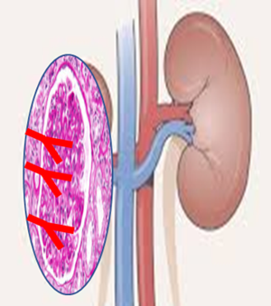
Practical Application: Case Study
Haplotmatched
& No donor specific antibodies
Epitope sharing between donor specific antigens and antigens against which recipient pre-formed antibodies
Rejection
Why?
  B*15:02 shares epitope (44RMA) with donor specific B*57:01 antigen showing MFI 19203
  B*07:02 shares epitope (69AA) with donor specific B*57:01 antigen showing MFI 18224
  DRB1*01:02, shares epitope (13FE) with donor specific DRB1*10:01 antigen showing MFI 2330
HLA antibodies are primary cause of transplant rejection; they recognize epitopes that can be structurally defined
Understating of Structural characteristics of epitope is the new beginning…………..

Slide 7
Conclusion
Number of antibody verified eplets correlated with biopsy findings forC4D analysis
HLA is highly polymorphic in India
Epitope matching can identify 'unacceptable mismatches’ which may lead to rejection and de novo donor specific development.
Therefore , epitope matching may be an effective tool for reducing chronic antibody mediated rejection and improving long term graft outcomes.
‘Epitope matching’ the MUST addition in donor selection algorithms

Slide 8


Affiliations
Deakin University, Melbourne, Australia
Reliance Life Sciences, Navi Mumbai, India
drahalkar@deakin.edu.au

